Slide 1
AUTOMATIC WATERING SYSTEM FOR PLANTS
SUBMITTED BY,
SREELAKSHMI KRISHNANKUTTY – C0765644
GROUP - 6

Slide 2

INTERFACING OF MOTOR DRIVER WITH BEAGLEBONE BLACK

Slide 3
HARDWARE REQUIREMENTS
Beaglebone black
L298N Motor driver
Mini submersible water pump
Battery 5V
Soil moisture sensor
Jumper wires

Slide 4
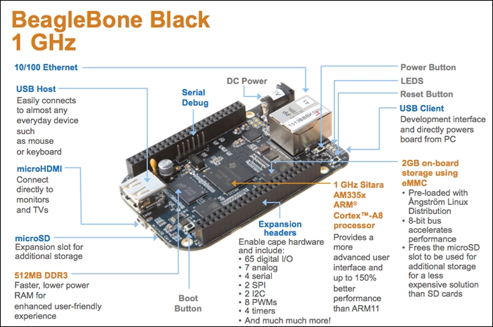
BEAGLEBONE BLACK
As in every computer, the board consists of a power button to turn on and turn off the board and a reset button to reset the board. In addition, there is a boot button which is used to boot the board when the operating system is loaded on the microSD card instead of the eMMC.There is a type A USB Host port to which you can connect peripherals such as USB Keyboard, USB Mouse, USB Camera, and much more, provided that the Linux drivers are available for the peripherals you connect to the BeagleBone Black.You can connect the BeagleBone Black to the LAN or Internet using the Ethernet port available on the board using an Ethernet cable. You can even use a USB Wi-Fi module to give Internet access to your BeagleBone Black.

Slide 5
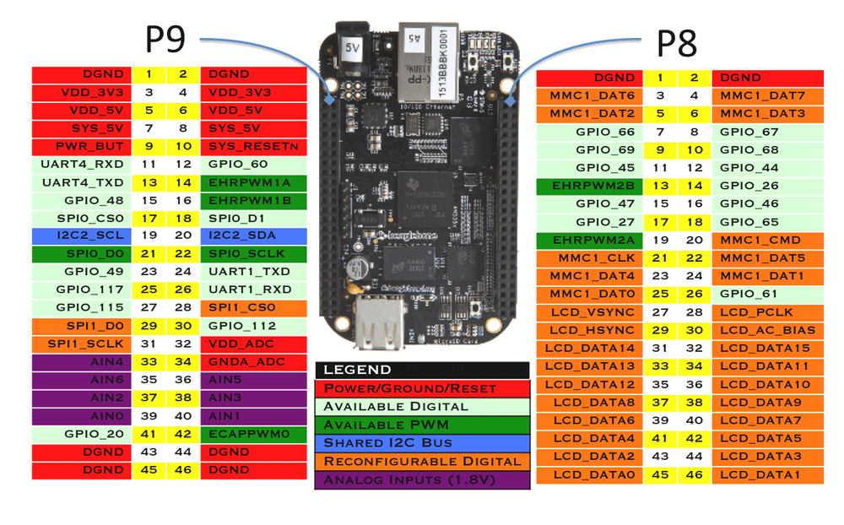
BEAGLEBONE BLACK
There are 65 digital pins on the expansion headers, which are also known as General-Purpose Input Output (GPIO) pins.

Slide 6
BEAGLEBONE BLACK
These pins can be used as digital input or output pins to which you can connect switches, LEDs and many more digital input output components, 7 analog inputs to which you can connect analog sensors like a potentiometer or an analog temperature sensor, 4 Serial Ports to which you can connect Serial Bluetooth or Xbee Modules for wireless communication or anything else, 2 SPI and 2 I2C Ports to connect different modules such as sensors or any other modules using SPI or I2C communication.

Slide 7
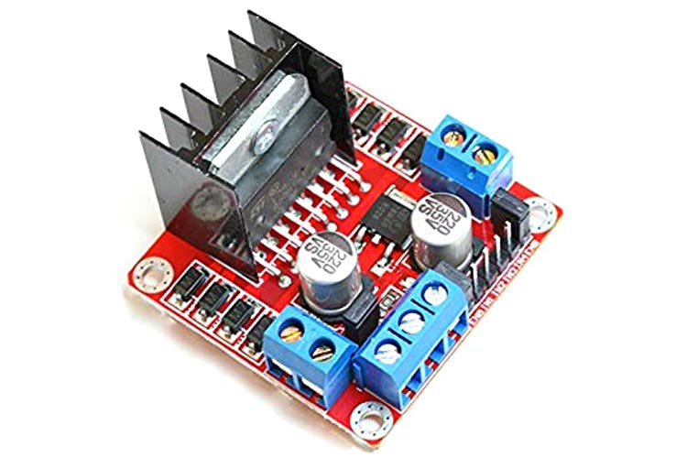
L298N MOTOR DRIVER
This L298N Motor Driver Module is a high-power motor driver module for driving DC and Stepper Motors. This module consists of an L298 motor driver IC and a 78M05 5V regulator.

Slide 8
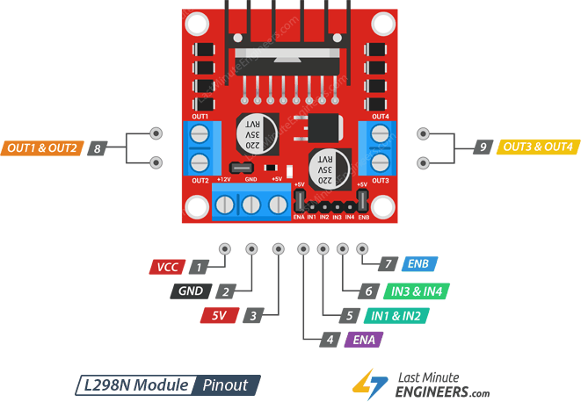
L298N MOTOR DRIVER – PIN OUT
VCC pin supplies power for the motor.
GND is a common ground pin.
5V pin supplies power for the switching logic circuitry inside L298N IC.
ENA pins are used to control speed of Motor A.
IN1 & IN2 pins are used to control spinning direction of Motor A. When one of them is HIGH and other is LOW, the Motor A will spin. If both the inputs are either HIGH or LOW the Motor A will stop.
OUT1 & OUT2 pins are connected to Motor A.

Slide 9
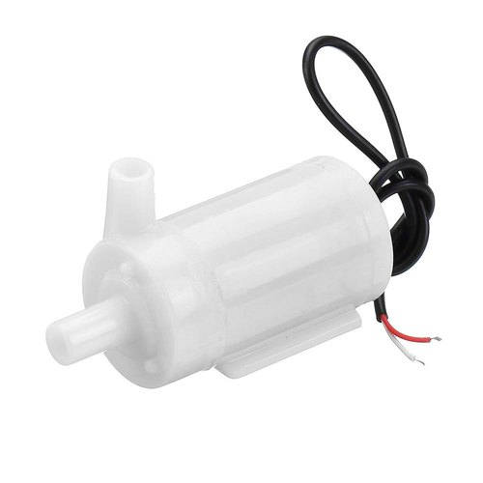
MINI SUBMERSIBLE WATER PUMP
Voltage range (V): DC2.5-6v
Rated voltage: DC3V or 4.5V
No load of water discharge capacity: 100L / H

Slide 10
MINI SUBMERSIBLE WATER PUMP
Load rated current: 0.18A
The pump is a DC pump, 3V pump with DC3-4.5V power supply (Can not be used directly with 220V AC voltage)

Slide 11
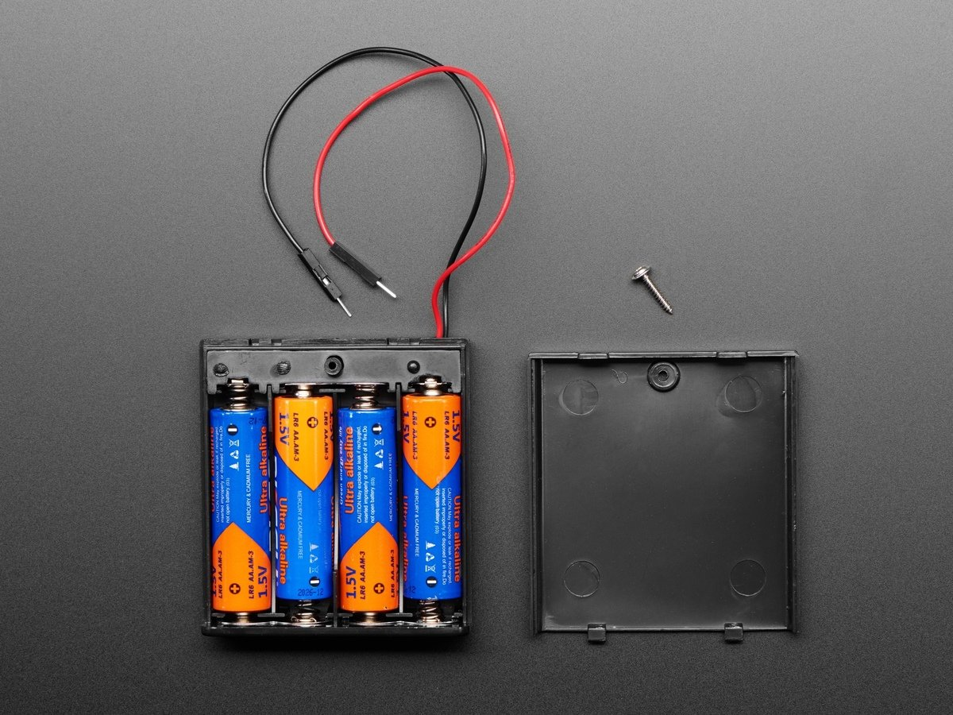
BATTERY
Here, In order to provide 5V power supply, we are using a battery holder with 4 AA batteries which in output gives approximately 5V.

Slide 12
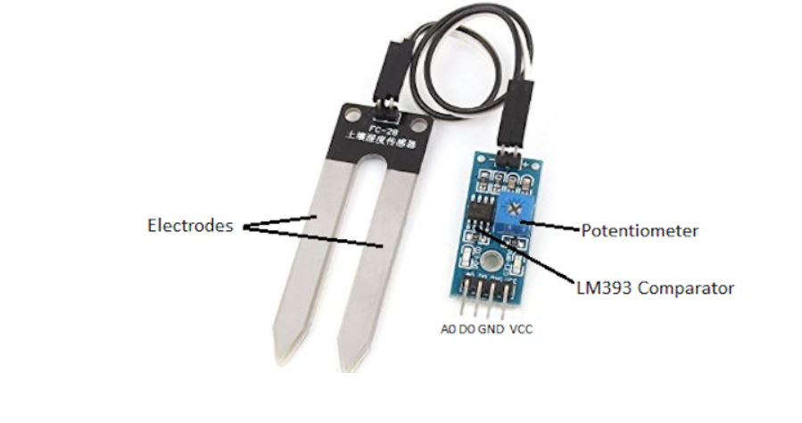
SOIL MOISTURE SENSOR (FC-28)
The specifications of the FC-28 soil moisture sensor are as follows:
Input Voltage: 3.3–5V
Output Voltage: 0–4.2V
Input Current: 35mA
Output Signal: both analog and digital

Slide 13
SOIL MOISTURE SENSOR (FC-28)
PIN-OUT
The FC-28 soil moisture sensor has four pins:
VCC: Power
A0: Analog Output
D0: Digital Output
GND: Ground

Slide 14
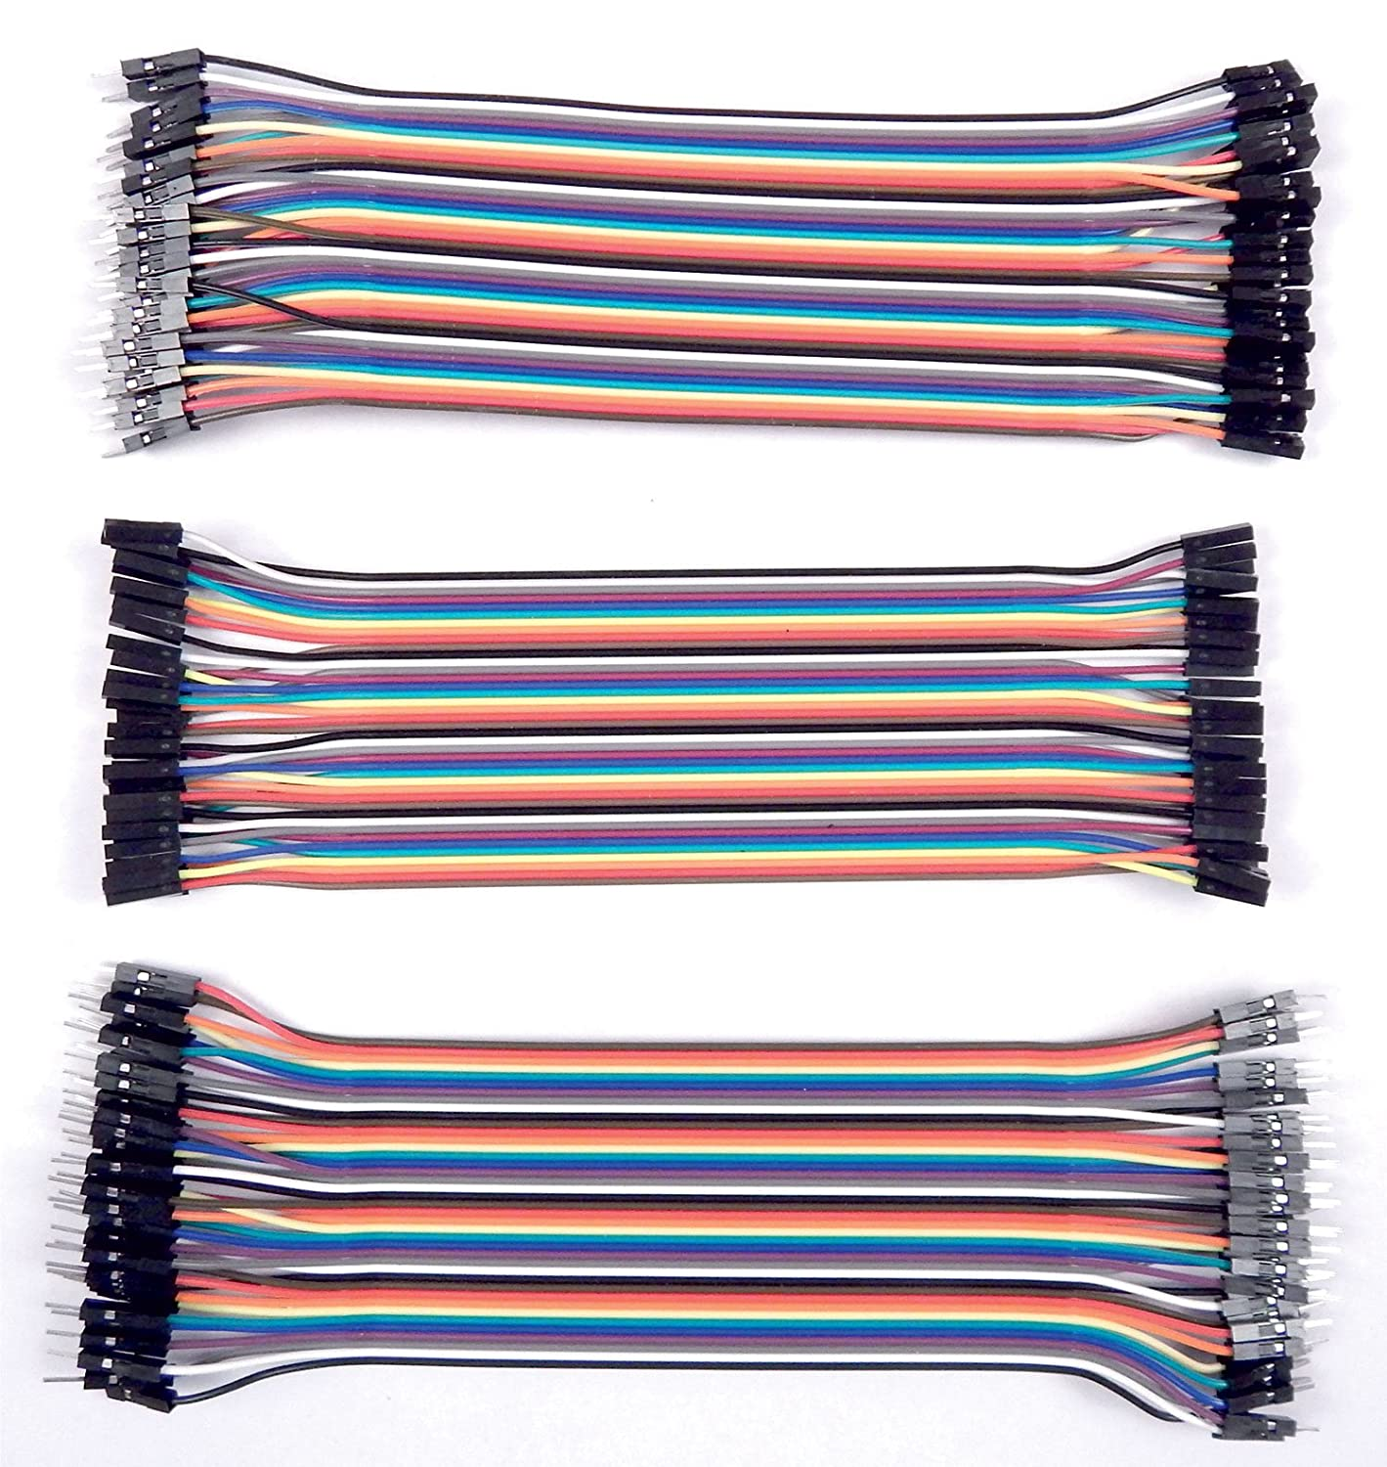
JUMPER WIRES
We are using all three kinds of jumper wires to make the connections.

Slide 15

SOFTWARE REQUIREMENTS
PUTTY
PuTTY is a terminal emulator, serial console, and network file transfer programme that is free and open-source.
SCP, SSH, Telnet, rlogin, and raw socket connections are among the network protocols it supports.
PuTTY can also be connected to a serial port.

Slide 16
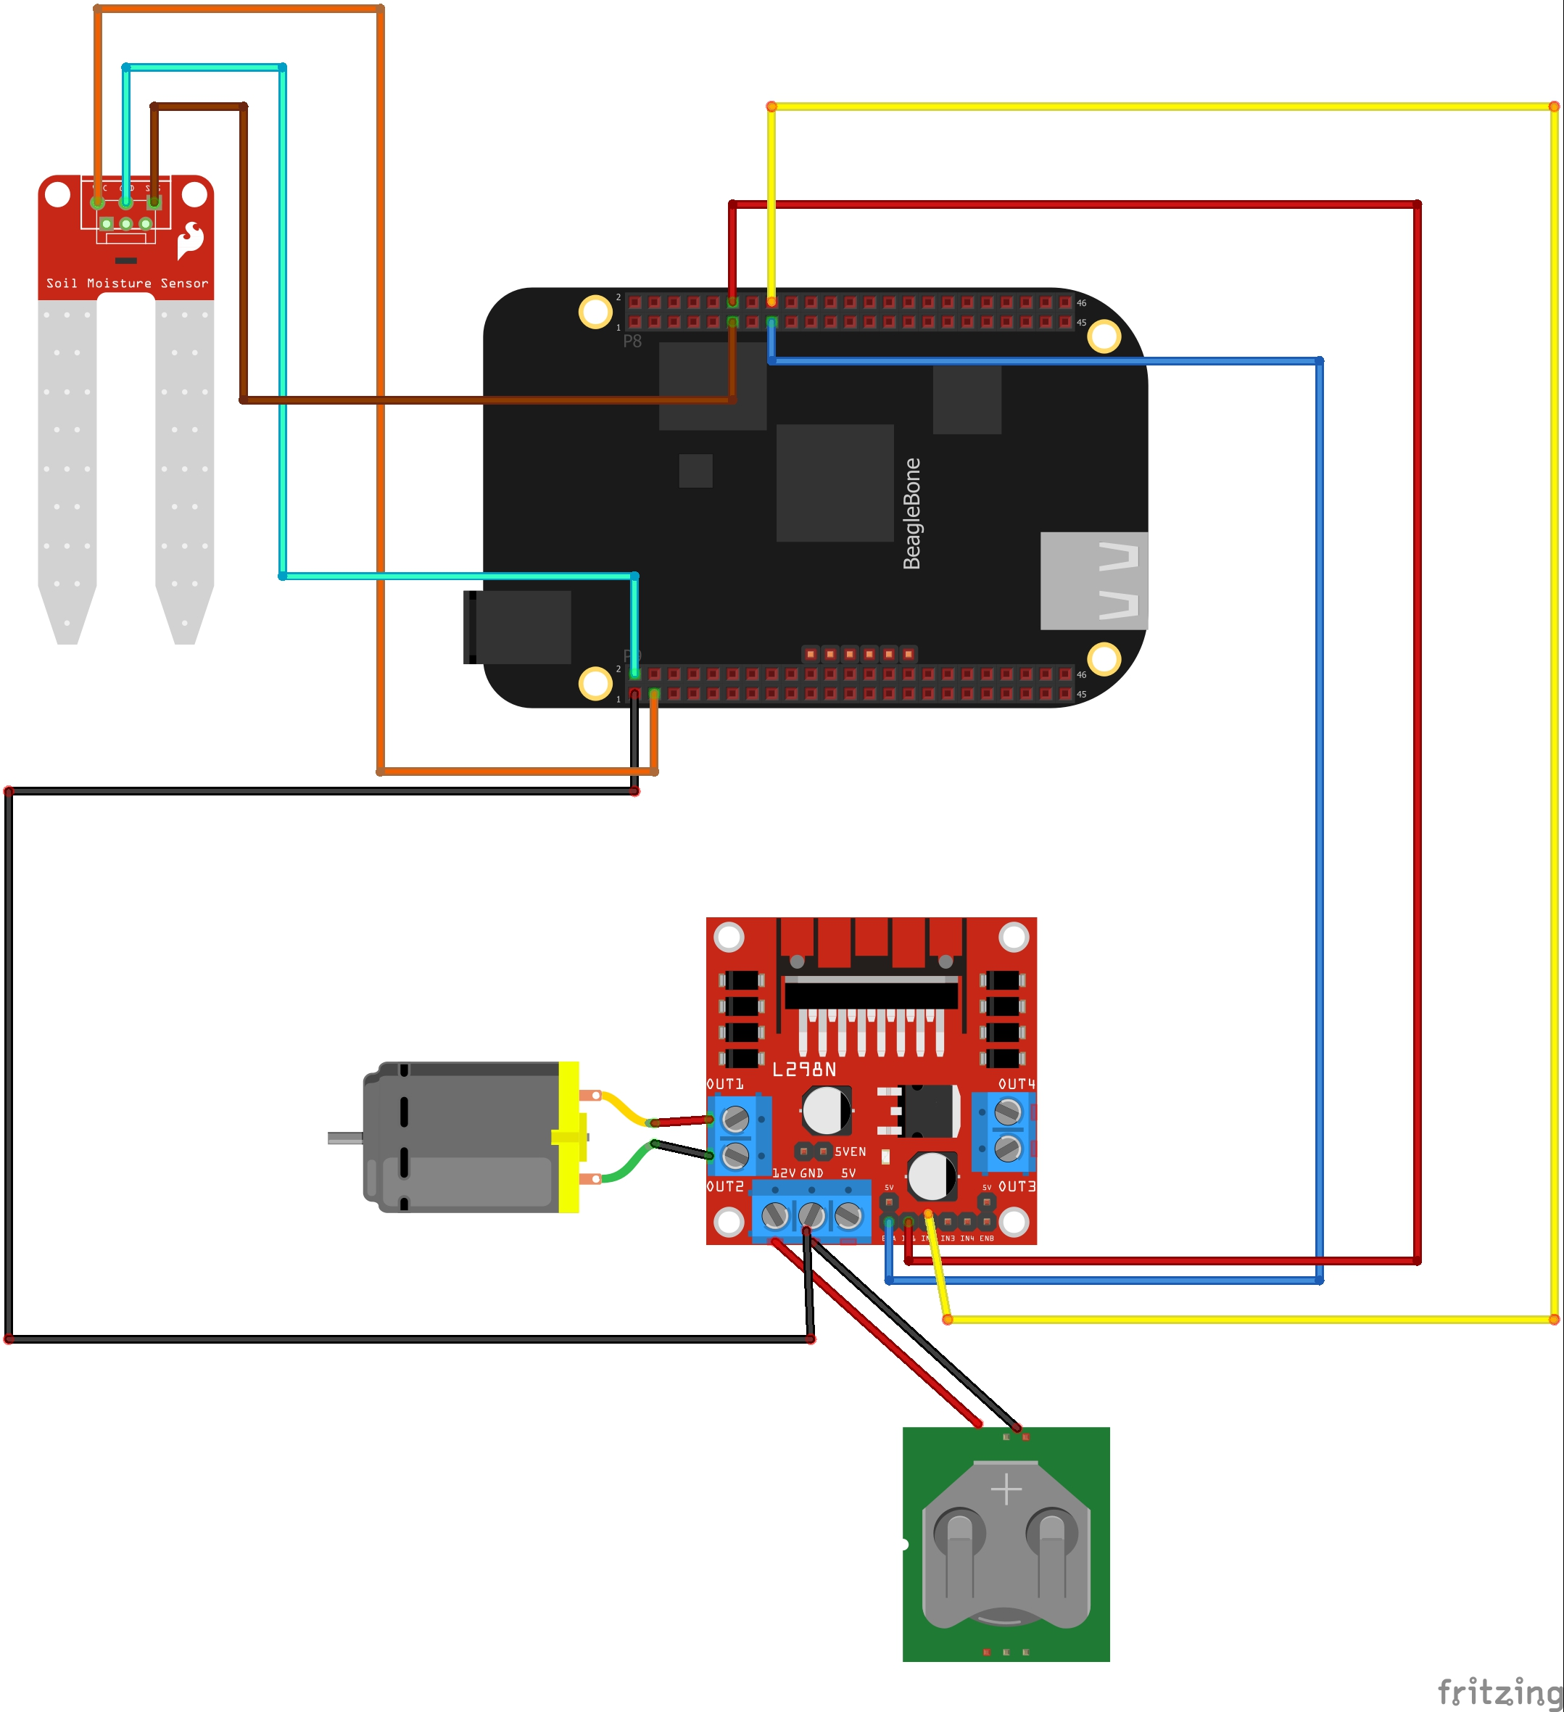
CONNECTION DIAGRAM CREATED USING FRITZING SOFTWARE

Slide 17
WIRING
The VCC of soil moisture sensor is connected to the 3RD pin of P_9.
The ground pin of soil moisture sensor is connected to the 1ST pin of p_9 in beaglebone black
The D0 of soil moisture sensor is connected to the 11TH pin of P_8 in beaglebone black.

Slide 18
WIRING
The positive and negative terminals from the battery holder are connected to the power supply pins of L298N motor driver.
The common ground is connected to the ground pin of beaglebone black, ie, 1ST pin of P_9 in beaglebone black.

Slide 19
WIRING
The enable A, ENA of the motor driver is connected to the 15TH pin of P_8 header in beaglebone black.
The IN1 of motor driver is connected to the 12TH pin of P_8 header in beaglebone black.
The IN2 of motor driver is connected to the 16TH pin of P_8 header in beaglebone black.

Slide 20
WIRING
The OUT1 AND OUT2 screw terminals of the motor driver are connected to the pump respectively.

Slide 21
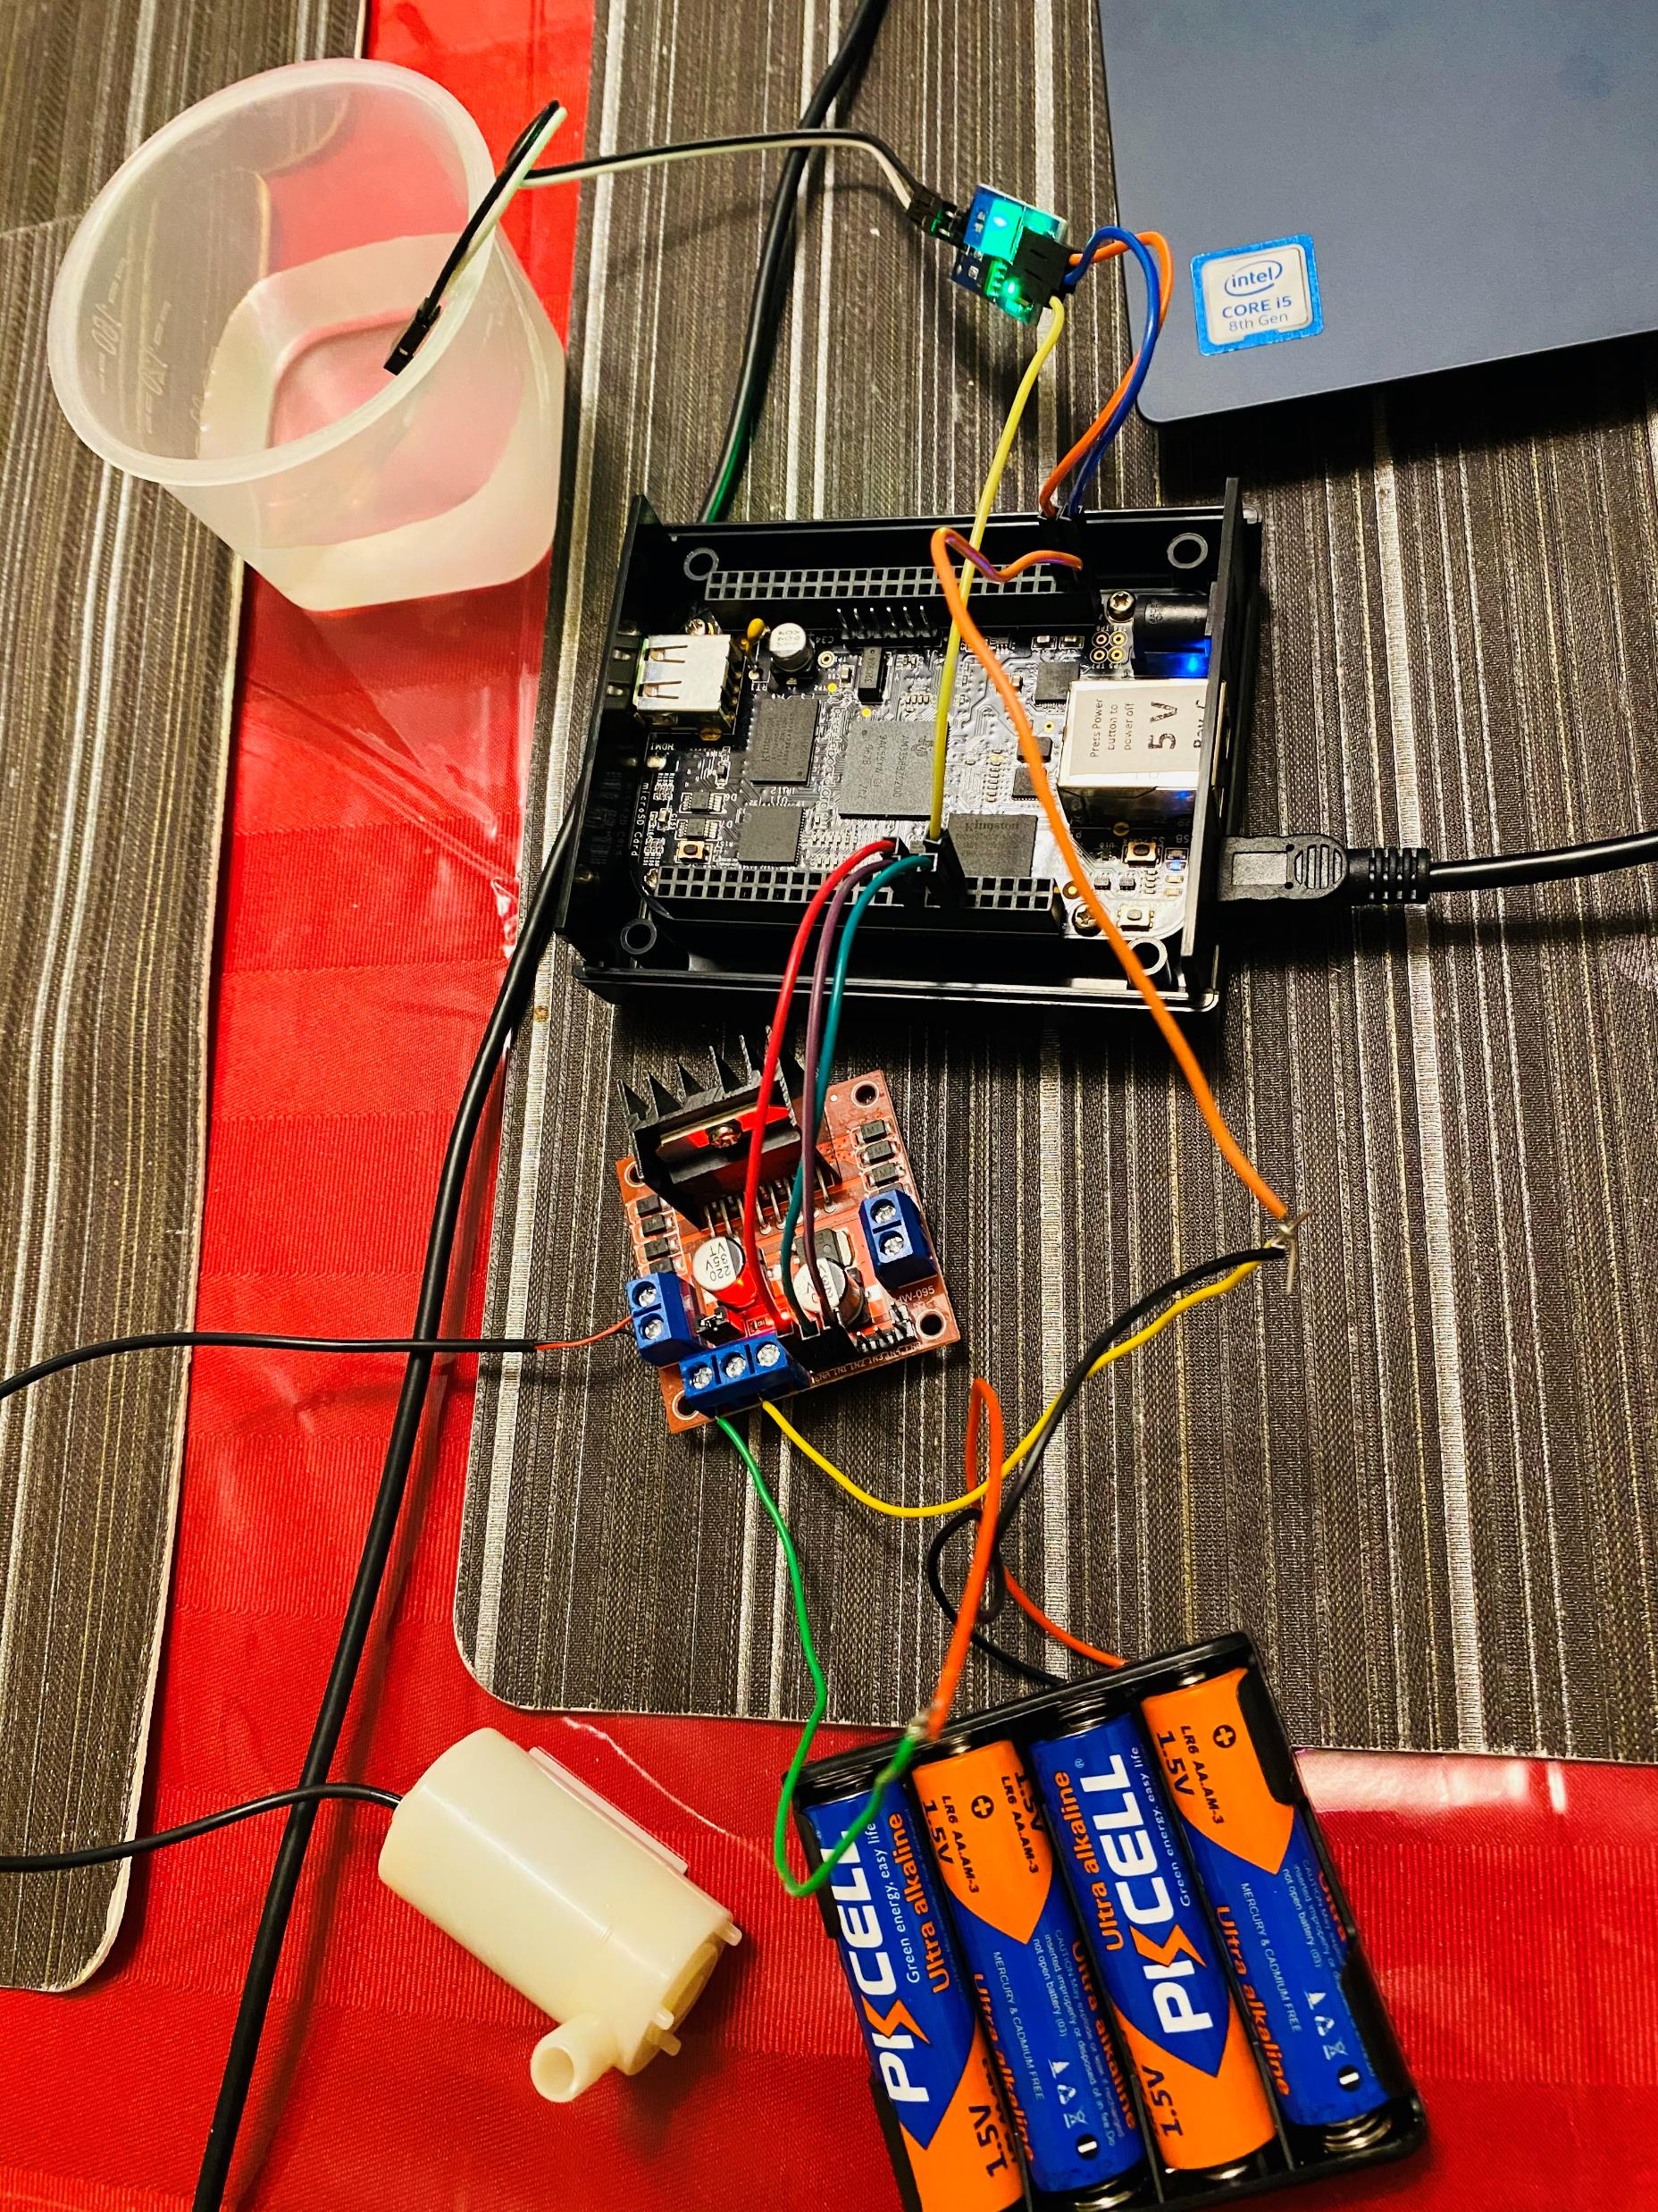
HARDWARE CONNECTION IMAGE

Slide 22
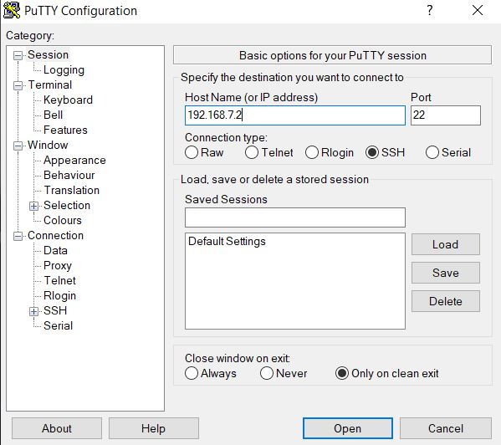
CONNECTING BEAGLEBONE BLACK VIA PUTTY SOFTWARE
Power the beaglebone black
SSH with windows and PuTTY
Enter the ip address 192.168.7.2 and then click open

Slide 23
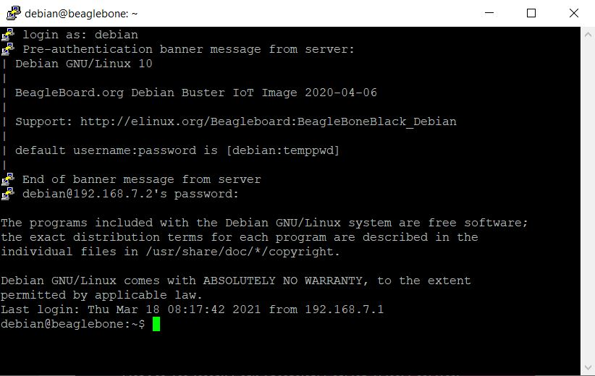
CONNECTING BEAGLEBONE BLACK VIA PUTTY SOFTWARE
After opening the PUTTY window, we have to login as Debian and then enter the password.

Slide 24
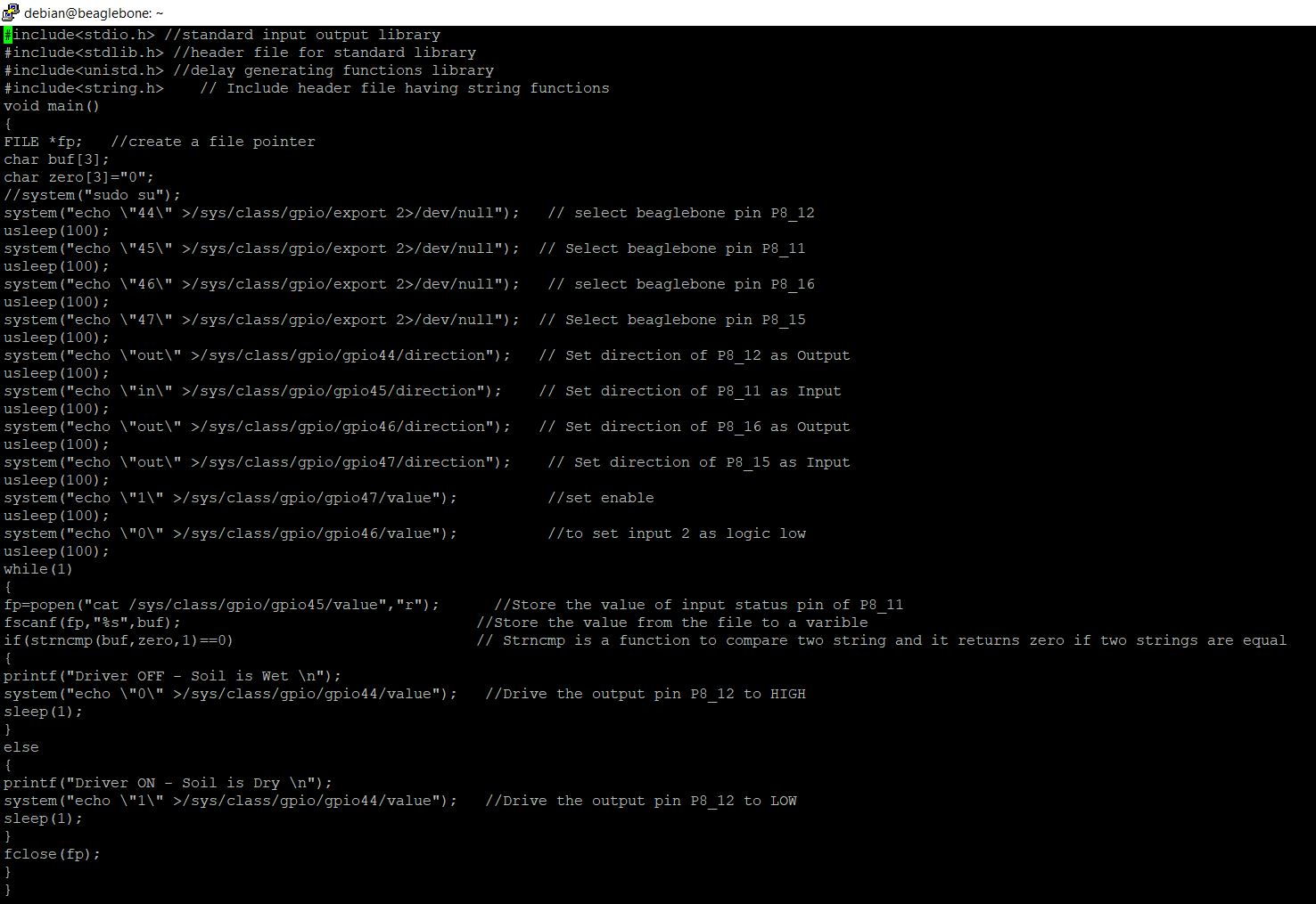
CREATING THE FILE
We create the file using the command vim.tiny and then we add the code in the file.

Slide 25
CODE EXPLANATION
#include<stdio.h> //Used for standard input and output
#include<stdlib.h> //header file for standard library
#include<unistd.h> //for the delay generating functions
#include<string.h> // Include header file having string functions
void main()
{
FILE *fp; //create a file pointer
char buf[3]; //declaring a string
char zero[3]="0"; //storing the value 0 in a string
//system("sudo su"); //to access root function
system("echo \"44\" >/sys/class/gpio/export 2>/dev/null"); // select beaglebone pin P8_12
usleep(100);

Slide 26
CODE EXPLANATION
system("echo \"45\" >/sys/class/gpio/export 2>/dev/null"); // Select beaglebone pin P8_11
usleep(100);
system("echo \"46\" >/sys/class/gpio/export 2>/dev/null"); // select beaglebone pin P8_16
usleep(100);
system("echo \"47\" >/sys/class/gpio/export 2>/dev/null"); // Select beaglebone pin P8_12
usleep(100);
system("echo \"out\" >/sys/class/gpio/gpio44/direction"); // Set direction of P8_12 as Output
usleep(100);
system("echo \"in\" >/sys/class/gpio/gpio45/direction"); // Set direction of P8_11 as Input
usleep(100);
system("echo \"out\" >/sys/class/gpio/gpio46/direction"); // Set direction of P8_16 as Output
usleep(100);
system("echo \"out\" >/sys/class/gpio/gpio47/direction"); // Set direction of P8_15 as Input
usleep(100);

Slide 27
CODE EXPLANATION
system("echo \"1\" >/sys/class/gpio/gpio47/value"); //set enable
usleep(100);
system("echo \"0\" >/sys/class/gpio/gpio46/value"); //to set input 2 as logic low
usleep(100);
while(1)
{
fp=popen("cat /sys/class/gpio/gpio45/value","r"); //Store the value of input status pin of P8_11
fscanf(fp,"%s",buf); //Store the value from the file to a varible
if(strncmp(buf,zero,1)==0) // Strncmp is a function to compare two string and it returns zero if two strings are equal
{
printf("Driver OFF - Soil is Wet \n"); //to print output

Slide 28
CODE EXPLANATION
system("echo \"0\" >/sys/class/gpio/gpio44/value"); //Drive the output pin P8_12 to HIGH
sleep(1); //to make the processor wait for 1 second
}
else
{
printf("Driver ON - Soil is Dry \n"); //to print the output
system("echo \"1\" >/sys/class/gpio/gpio44/value"); //Drive the output pin P8_12 to LOW
sleep(1); //to make the processor wait for 1 second
}
fclose(fp); //close the file which is pointed by an open file pointer.
}
}

Slide 29
FINAL OUTPUT
After running the code, if there is no moisture detected, the pump will turn on and if there is moisture content, the pump will be turned off.

Slide 30
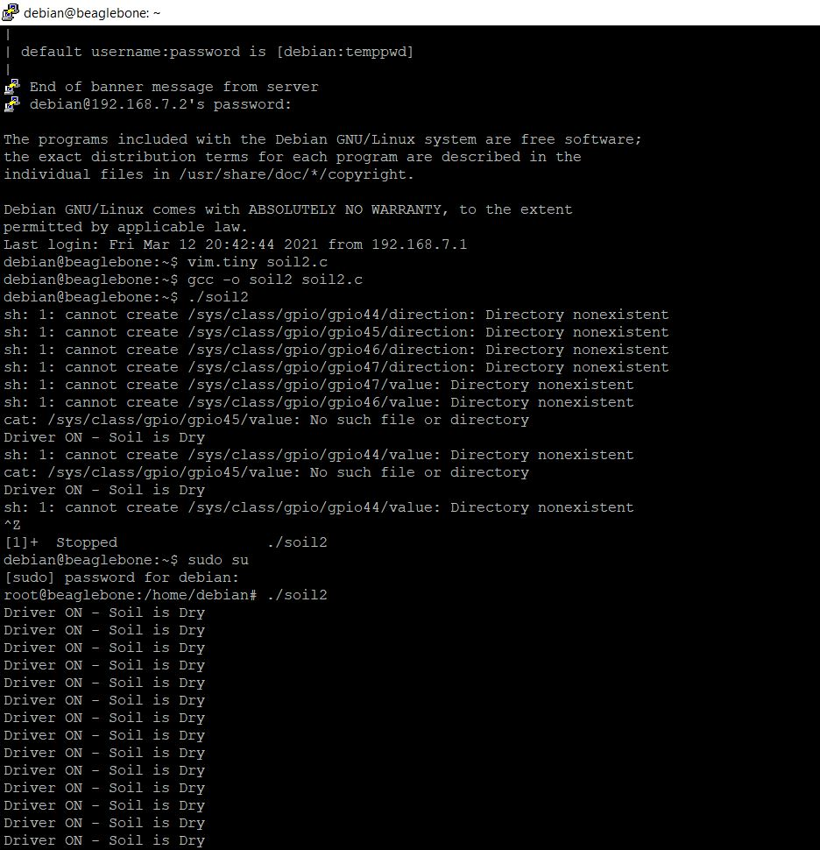
OUTPUT WHEN THERE IS NO MOISTURE CONTENT
The pump will be turned ON and start pumping water until the moisture content is found.

Slide 31
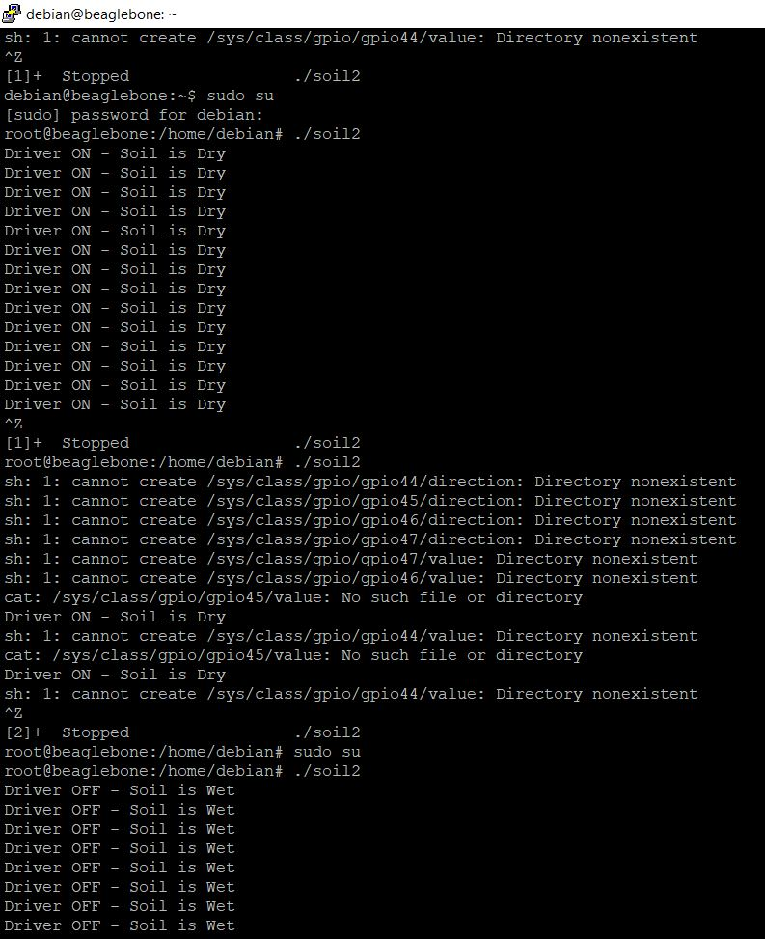
OUTPUT WHEN THERE IS MOISTURE CONTENT
The pump will be turned OFF when the soil gets the moisture content.

Slide 32
REFERENCES
BEAGLEBONE BLACK SPECIFICATIONS: https://subscription.packtpub.com/book/hardware_and_creative/9781785285059/1/ch01lvl1sec11/hardware-specification-of-beaglebone-black
MOTOR DRIVER DATA SHEET : https://www.sparkfun.com/datasheets/Robotics/L298_H_Bridge.pdf
L298N Motor Driver : https://components101.com/modules/l293n-motor-driver-module

Slide 33
REFERENCES
Mini submersible water pump : https://www.amazon.ca/gp/product/B07BKXJXK1/ref=ppx_yo_dt_b_asin_title_o05_s00?ie=UTF8&psc=1
SOIL MOISTURE SENSOR SPECS: https://maker.pro/arduino/projects/arduino-soil-moisture-sensor
Battery : https://engineerexperiences.com/5-volt-supply.html

Slide 34
BBB Via putty : https://learn.adafruit.com/ssh-to-beaglebone-black-over-usb/ssh-with-windows-and-putty
L298N pin out : https://lastminuteengineers.com/l298n-dc-stepper-driver-arduino-tutorial/
DC MOTOR INTERFACING WITH BBB : https://www.engineersgarage.com/tutorials/dc-motor-interfacing-with-beaglebone-black/
L298N INTERFACING WITH BBB : https://beagleboard.org/p/silver2row/beaglebone-black-and-l298-motor-driver-in-python-2156be
REFERENCES

Slide 35
THANKYOU

